Slide 1
The EU Semiconductor Strategy:
Adapting to a Changing Geopolitical Landscape
Léo Saint-Martin
Economist / Partner
12.11.2024
Notes:
Chips, Checks and Balances: The Geopolitics of Semiconductors

Slide 2
Agenda
Semiconductor, the World’s Most Globalized Sector
1990s - 2020s: A shifting Geopolitical Environment
Semiconductor: The rise of China and US attempts to contain it
Status of trades in semiconductor in this changing environment
The EU semiconductor strategy, Adapting to a Changing Geopolitical Landscape

Slide 3
(1)
Overview of the Semiconductor Industry
The World’s Most Globalized Sector

Slide 4
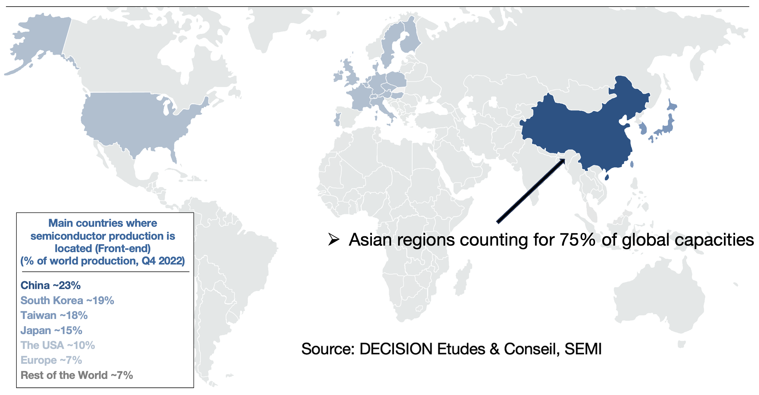
Semiconductor front-end manufacturing installed capacities in 2023
Notes:
Similar for Back-end, even more than 80% of the installed capacities in Asia

Slide 5
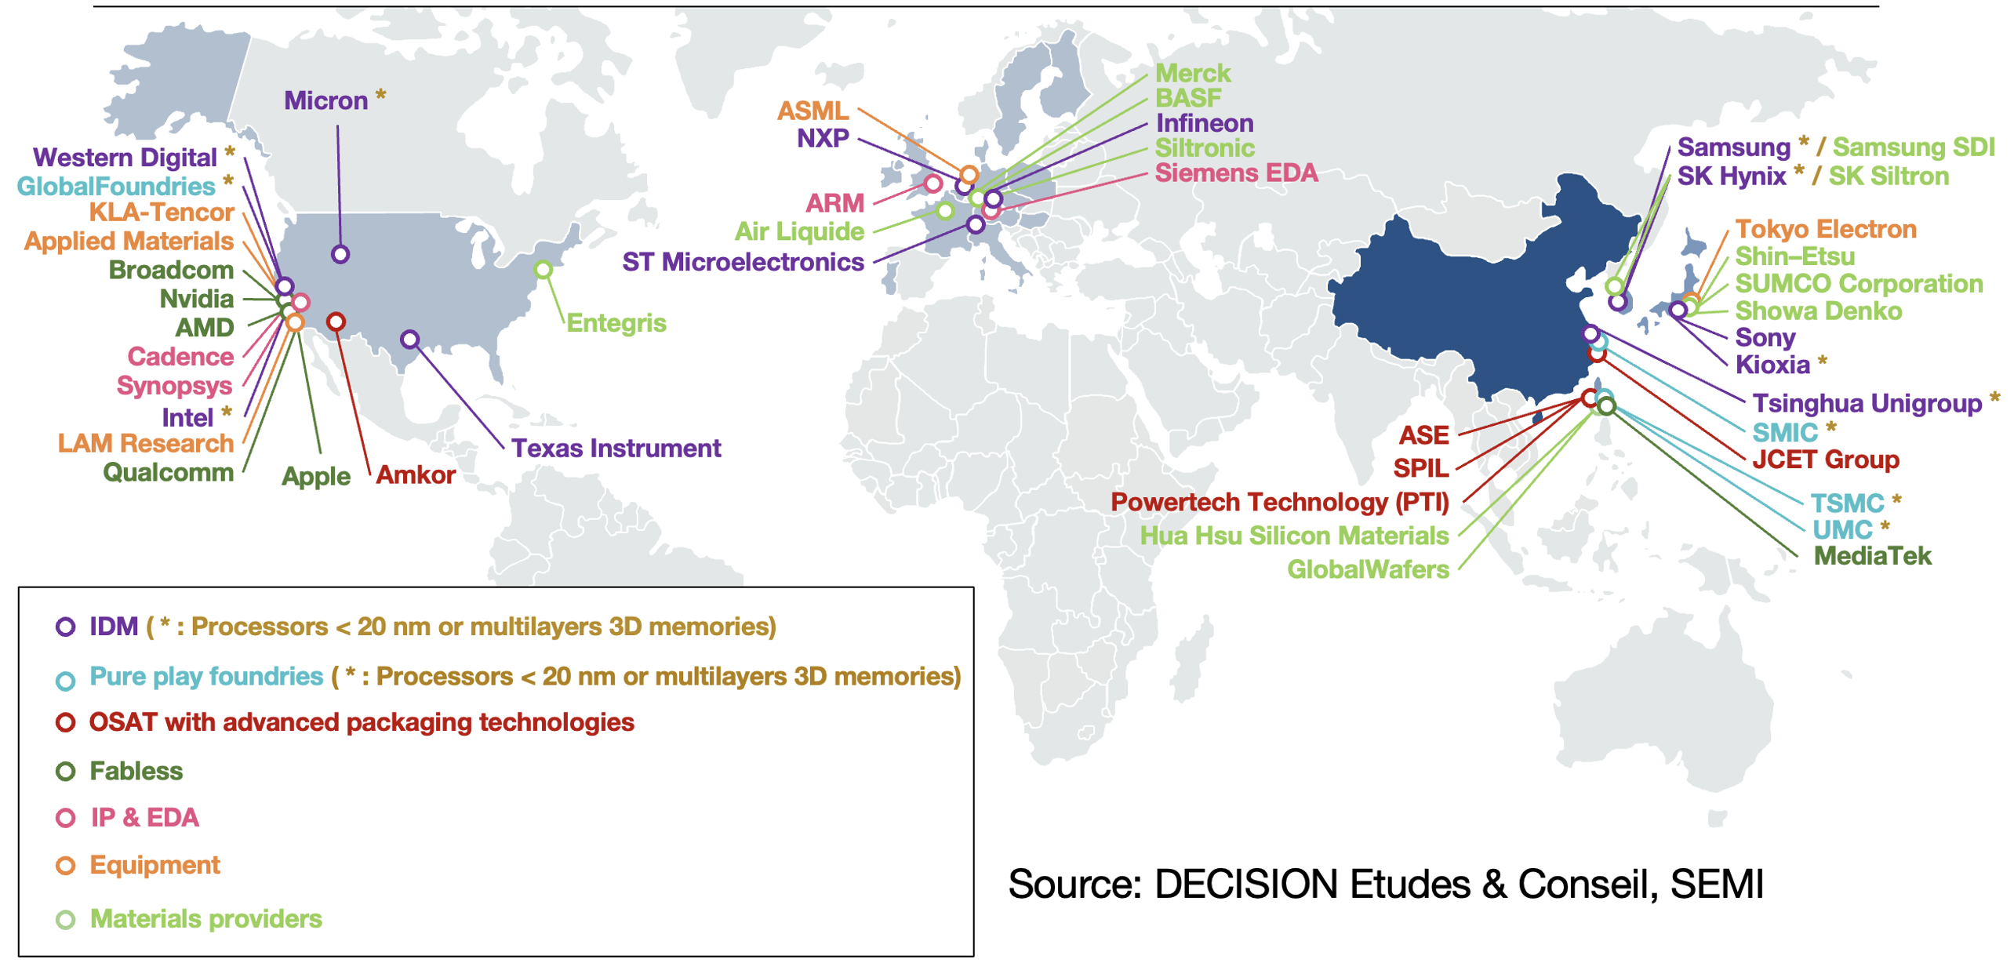
Semiconductor landscape in 2023
Notes:
The US, the only country with a complete mastering of the value chain. US Chips Act addressing the few weaknesses
China, willing to build a similar ecosystem, officially since 2015
Taiwan & South Korea, leading in manufacturing (Front-End, Back-End).
Europe and Japan, in similar positions: Strengths in IDMs, equipment and tools, with decreasing shares and trying to preserve their ecosystem

Slide 6
(2)
1990s – 2020s
A shifting Geopolitical Environment

Slide 7
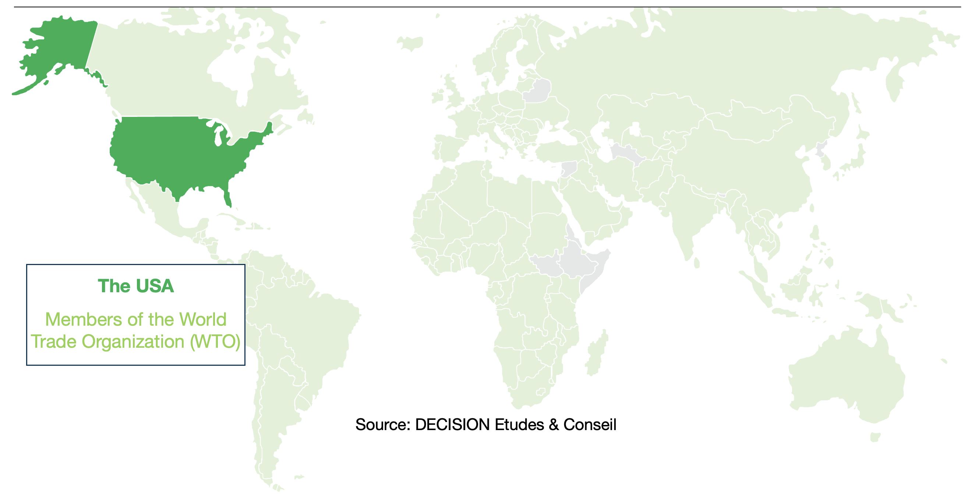
Globalization in a unipolar World (1991-2014)

Slide 8
Towards multipolarity (2000-2023)
Source: DECISION Etudes & Conseil, World Bank
2014
Annexation of Crimea by Russia
New Development Bank of the BRICS
2019
U.S. Blockade of the WTO Appellate Body
2
3
1
2001
Creation of the Shanghai Cooperation Organization
Notes:
Possibilité ajouter Retrait US de l’accord sur le nucléaire Iranien en 2018
Idem Guerre en Ukraine (2021)

Slide 9
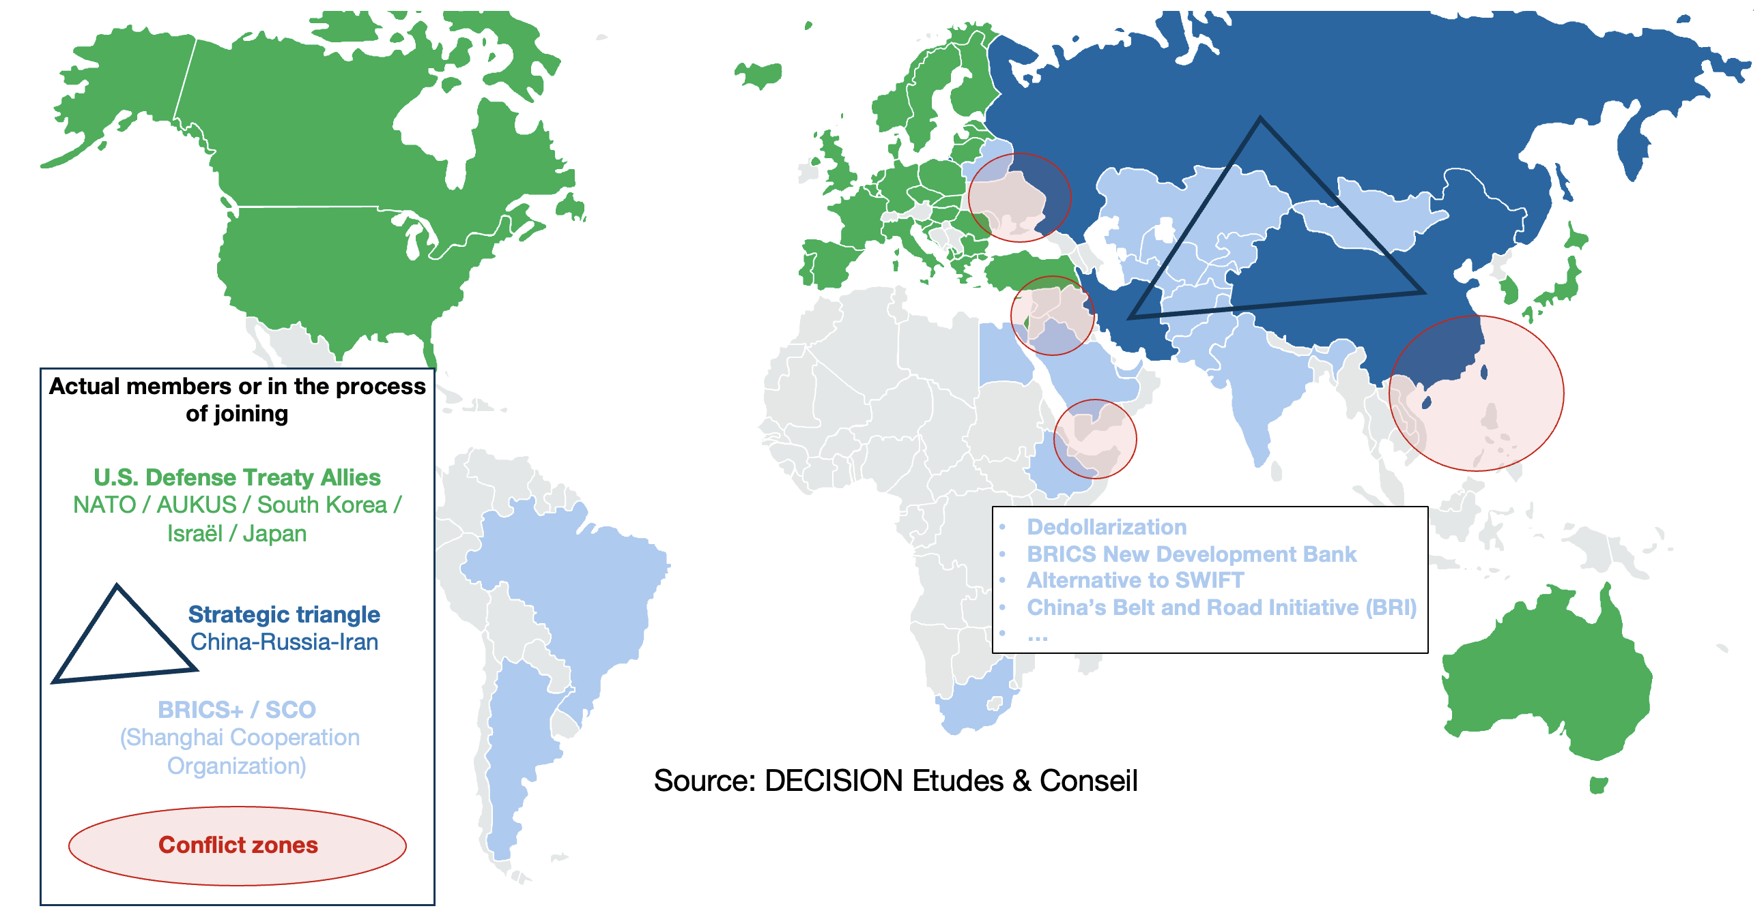
Towards a logic of blocks? (2014-?)

Slide 10
De-coupling? De-risking?
China designated by the West as
“Systemic rival”, various G7 declaration since 2021
”Systemic challenge”, NATO 2022
Concerns about China’s non-market policies leading to spillovers, market distortions and harmful overcapacity, G7 2024
However, the last G7 Communiqué (Apulia Leaders’ June 2024) states
We are not decoupling or turning inwards. We are de-risking and diversifying supply chains where necessary and appropriate, and fostering resilience to economic coercion.
We further call on China to refrain from adopting export control measures, particularly on critical minerals, that could lead to significant global supply chain disruptions.
Notes:
China designated by the EU as
A « partner » for cooperation, an « economic competitor » and « a systemic rival », EC 2019
China is, simultaneously, in different policy areas, a cooperation partner with whom the EU has closely aligned objectives, a negotiating partner with whom the EU needs to find a balance of interests, an economic competitor in the pursuit of technological leadership, and a systemic rival promoting alternative models of governance. This requires a flexible and pragmatic whole-of-EU approach enabling a principled defence of interests and values. The tools and modalities of EU engagement with China should also be differentiated depending on the issues and policies at stake. The EU should use linkages across different policy areas and sectors in order to exert more leverage in pursuit of its objectives.

Slide 11
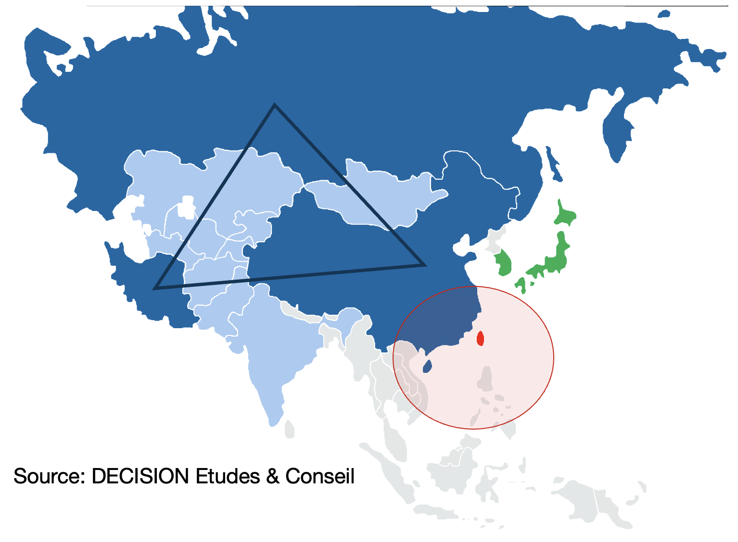
Primary Risk of Value Chain Disruption
Taiwan
1971 UN General Assembly resolution recognizing one single China
China will “not renounce the use of force” to unify Taiwan with the People’s Republic of China
May 2024 New Taiwanese President stating China "has no right to represent Taiwan" and his mission is to "resist annexation or encroachment upon our sovereignty.”

Slide 12
(3)
Semiconductor
The rise of China…
…and US attempts to contains China’s rise

Slide 13
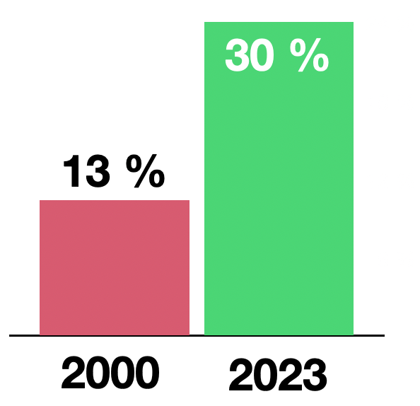
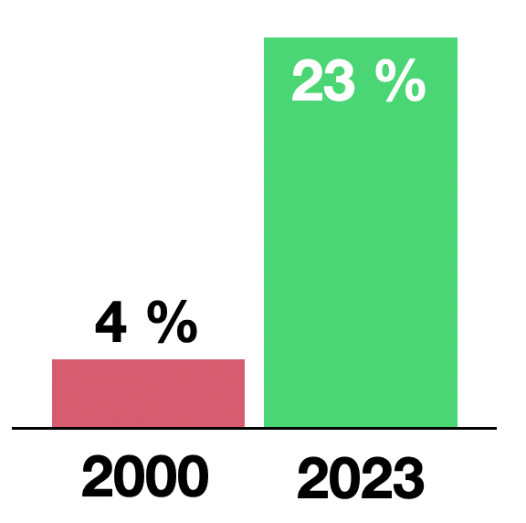
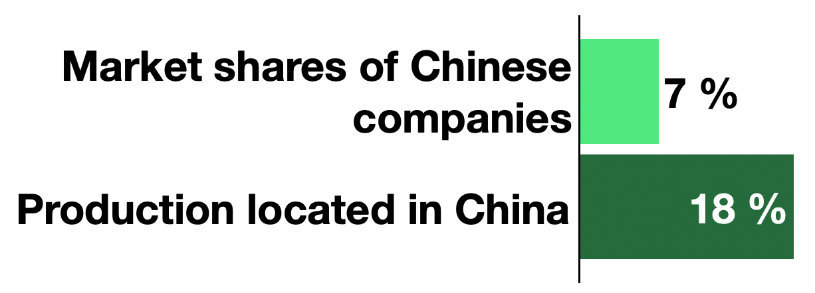
Semiconductor: The rise of China
In 2015, China published its plan “Made in China 2025” where it officially announce for the first time its willingness to master the complete value chain of semiconductor.
Installed capacity of semiconductor (Front-end)
China % World
Semiconductor market China % World
Across the entire semiconductor value chain in 2022
Sources: DECISION Etudes & Conseil, WSTS, SEMI
Notes:
Country : Prod / MS
EU : 10% 9%
Japan : 8% / 10%
The USA : 19% 44%
China : 18% 6.5%
Taiwan: 13% 15%
South Korea : 12% 14%
India : 7,4% 0,1%

Slide 14
US attempts to contains China’s rise
US industrial policy tools to contain China’s rise
FCPA (Foreign Corrupt Practices Act) (2008↑): The use of foreign corrupt practices to weaken key non-US companies and eventually purchase them.
BIS Entity list (2016 ↑) : Entities and products placed under extra-territorial embargo.
FIRRMA (Foreign Investment Risk Review Modernization Act) / CFIUS (2018) to monitor and control foreign investments, including in semiconductors: Qualcomm, Aixtron, Lattice Semiconductor, Siltronic, Western Digital, Lumileds…
Inflation Reduction Act (IRA) (2022). $369B by 2031 public funding, requiring domestic content ranging from 40% to 100% for different components and sectors to qualify for full subsidies and tax incentives.
Expansion of export control measures (dual use)
Trump elected: Universal tariff of 60% on all Chinese imports?
Possible retaliation from China: Export controls on critical minerals? Following Gallium and Germanium

Slide 15
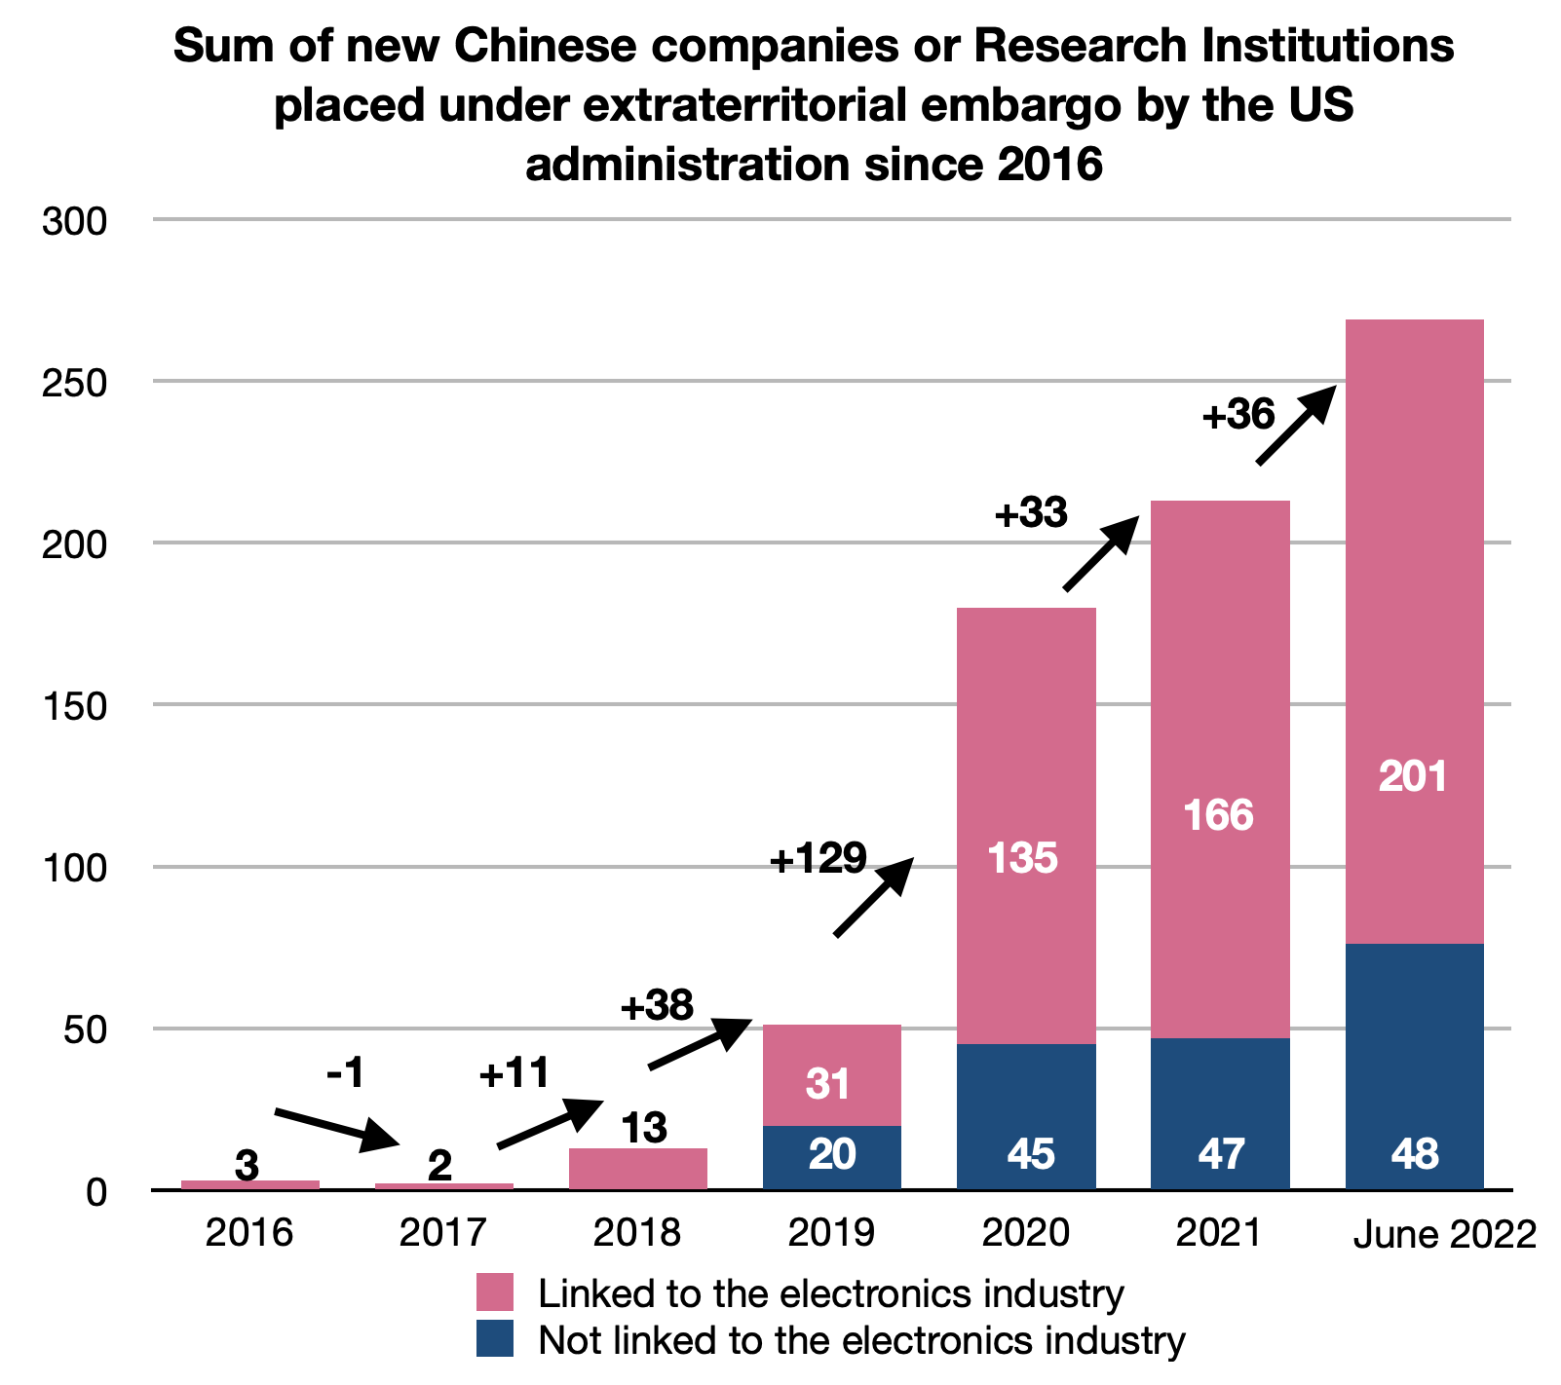
Summary of the export ban list on China from the US
Sum of new Chinese companies or Research Institutions placed under extraterritorial embargo by the USD administration since 2016
Source: DECISION Etudes & Conseil based on BIS data
Increasing every year
Notes:
In addition, the BIS added 10 entities on the entity list in 2023 and 26 in October 2024.

Slide 16
(4)
Status of trades in semiconductor
in this changing environment

Slide 17
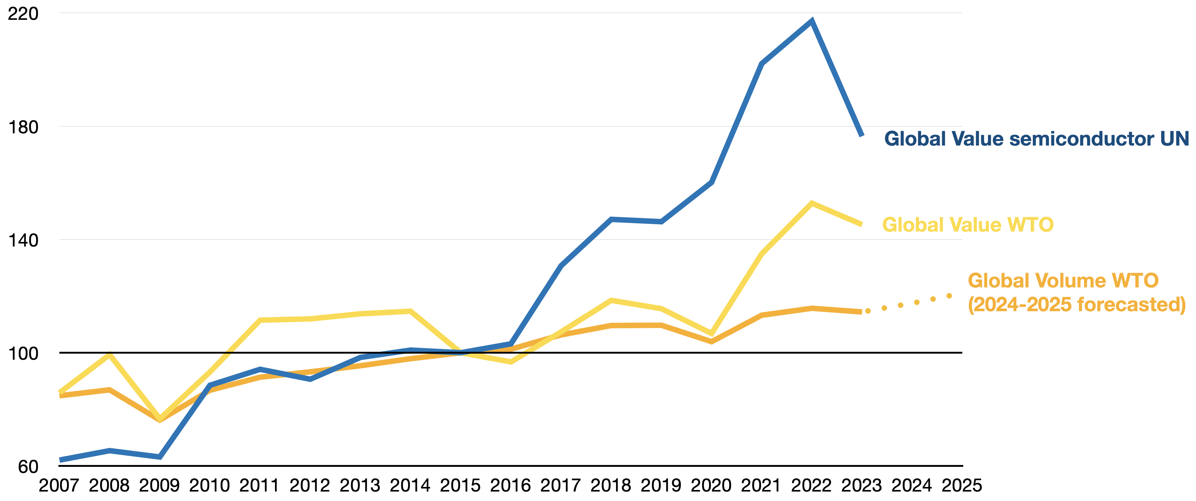
Evolution of Overall Global Trade Value/Volume
and Semiconductor Global Trade Value in the World (Indexed to 2015)
Source: DECISION Études & Conseil; UN Comtrade; WTO Stats
Notes:
Key message: Expansion of global trades and trades of semiconductor over the period. No real sign of regionalization of value chains, decoupling.
Backnotes:
The semiconductor market has experienced significant growth in recent years driven by the growing demand for cutting-edge technology that relies on semiconductors across all sectors of the economy. From 2016 to 2022 the compound annual growth rate for the total semiconductor market was an impressive 10,1 %^{[1]}. This period witnessed significant expansion, including a surge in DRAM and flash memory markets in 2017 and 2018, as well as strong post-COVID recovery in 2020 and 2022.
The semiconductor industry faced a substantial revenue decline in 2023, but there are signs of recovery. Market cyclicality played a crucial role in this downturn. The industry goes through periodic cycles of growth and decline, and 2023 was no exception. As is often the case, the memory chip market was the most volatile, explaining the 10.2 % decline in the market in 2023. Demand for DRAM and NAND flash memory weakened considerably, especially in smartphones, PCs, and servers, while the logic, analog and discrete markets have remained relatively flat. Beyond cyclical factors, the global economic downturn placed pressure on consumer disposable income, which in turn affected spending on electronic products such as PCs and smartphones where sales began falling in early 2022.
^{[1]} Sources : WSTS historical sales converted in euro.

Slide 18
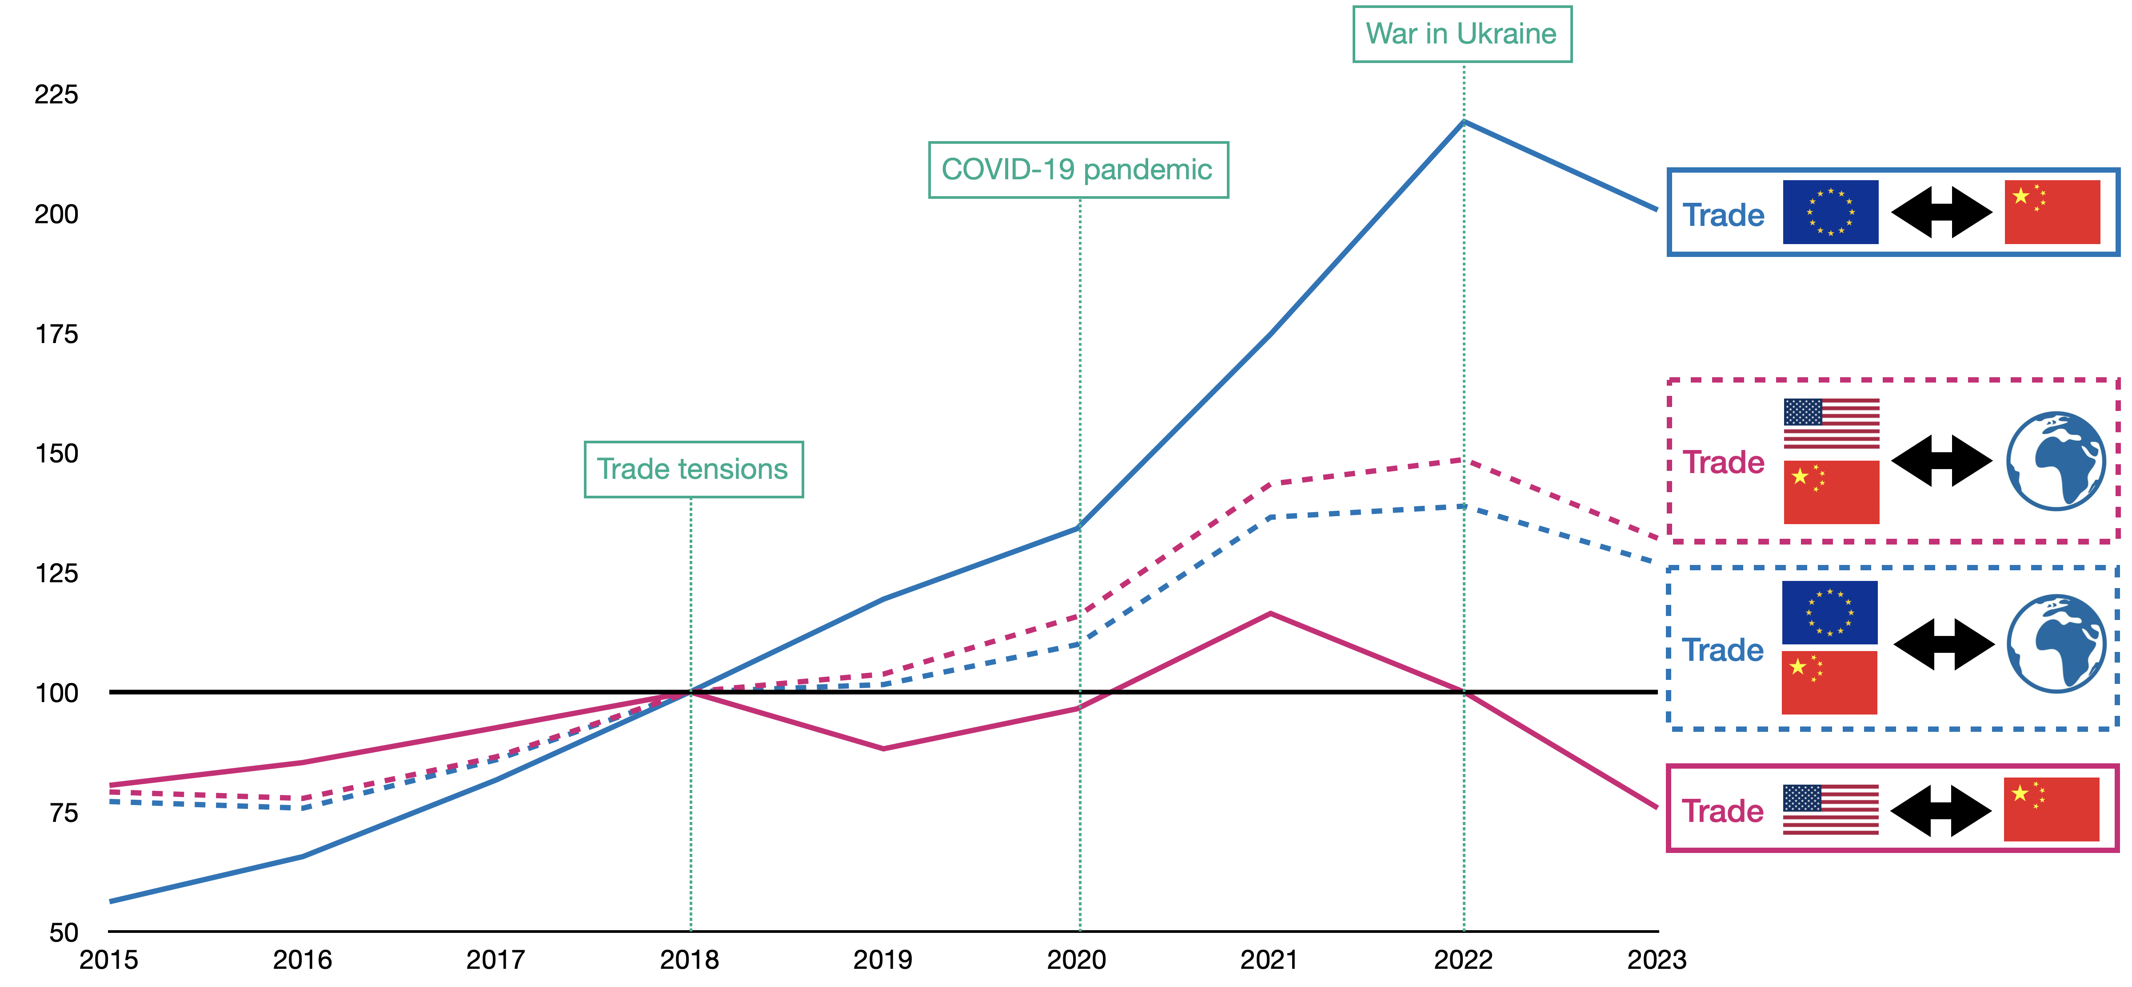
Semiconductor Trade Dynamics
Between US-China-EU Blocks (2015-2023) (2018=100)
Source: DECISION Études & Conseil; UN Comtrade

Slide 19
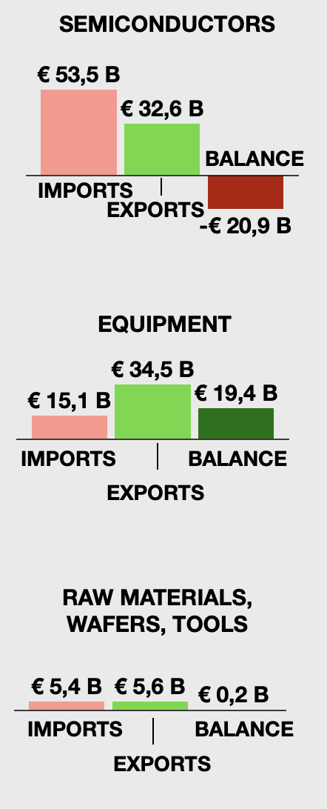
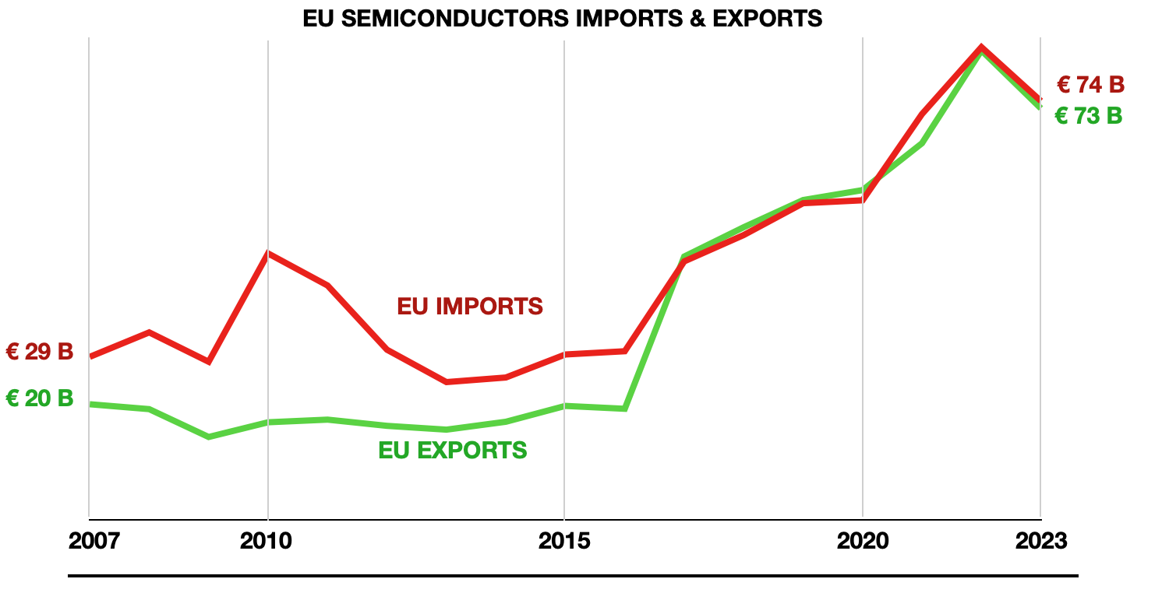
EU trade balance
Semiconductors, equipment, other
2023
Improvement of the trade balance thanks to the export of equipment
Source: DECISION Études & Conseil; Eurostat
Notes:
Top 5 importateurs Equipment 2022: (UE vers étranger):
Taiwan
Korea
US
China
United Kingdom
Top 5 importateurs Equipment 2023: (UE vers étranger):
Korea
US
Taiwan
China
United Kingdom
Top 6 importateurs Final Products 2023: (UE vers étranger):
China
Malaysia
Taiwan
United States
Singapore
Hong Kong
Top 6 fournisseurs de Final Products vers l’UE 2023: (étranger vers UE)
Taiwan
Malaysia
China
Korea
US
Israel
Top 5 fournisseurs de Raw Materials vers l’UE 2023: (étranger vers UE)
China
US
Norway
Japan
Russia

Slide 20
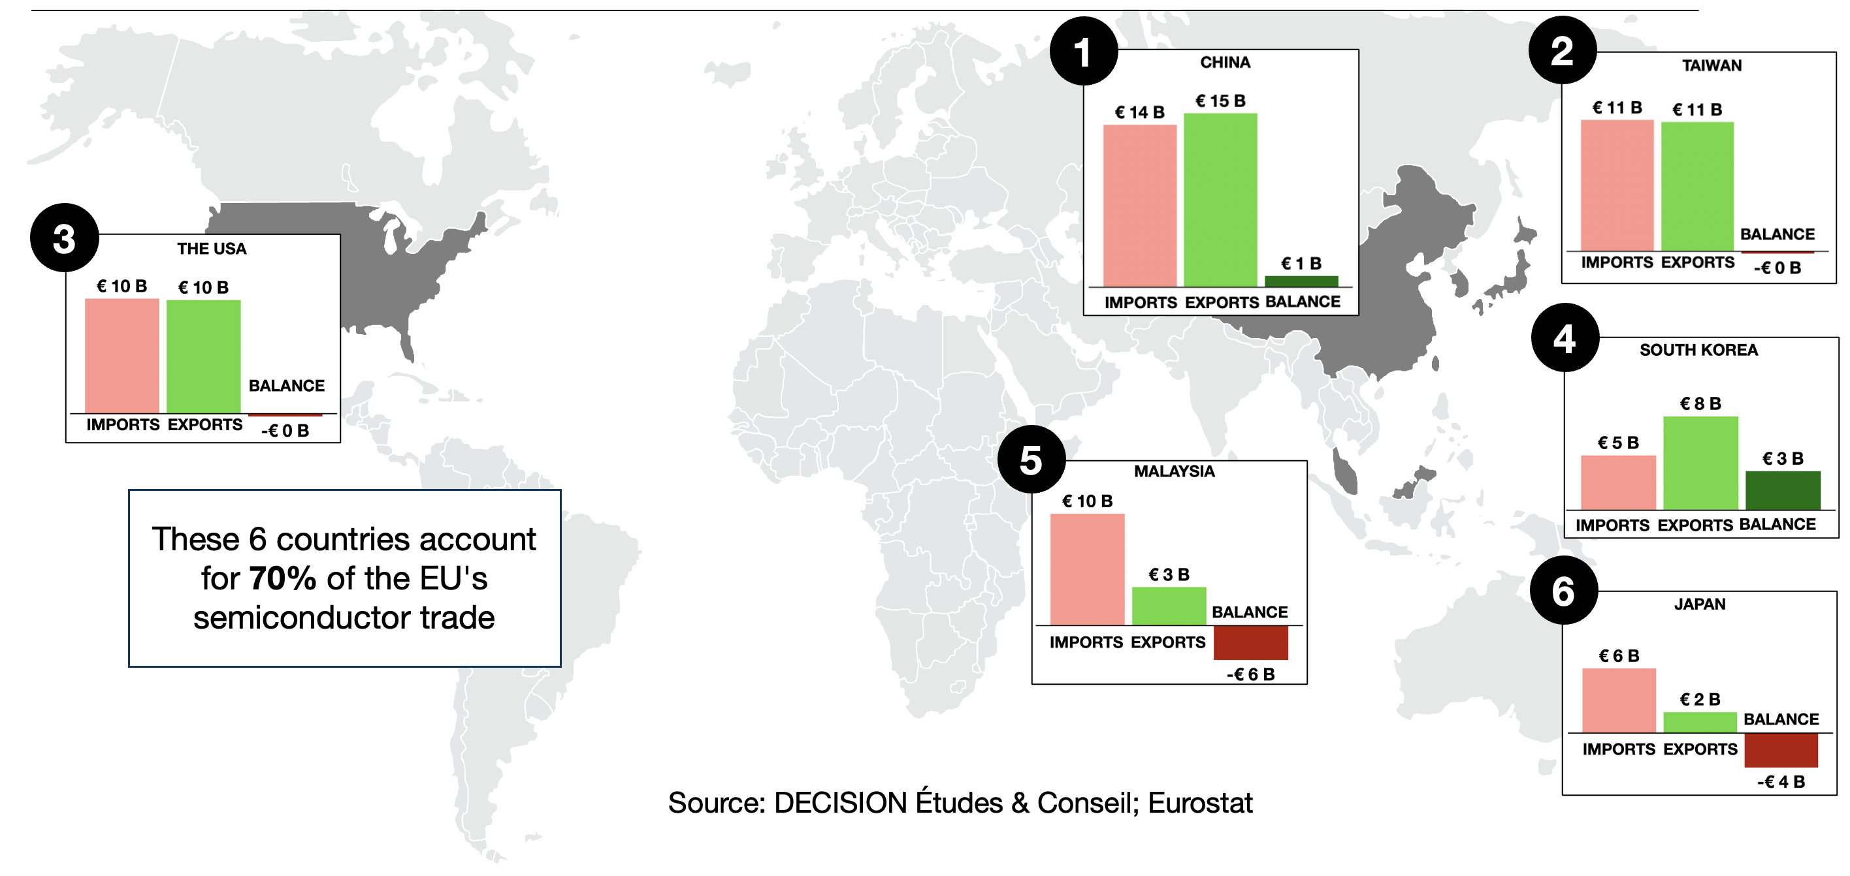
Main trading partners of the EU in semiconductors

Slide 21
(5)
The EU Semiconductor Strategy
Adapting to a Changing Geopolitical Landscape

Slide 22
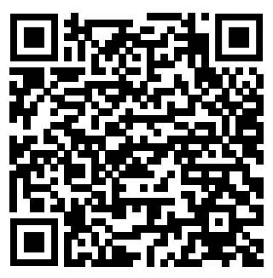
Report published in July 2024
Status of the semiconductor industries of 8 countries
& roadmap for cooperation in the confidential version shared to the Commission in February 2024

Slide 23
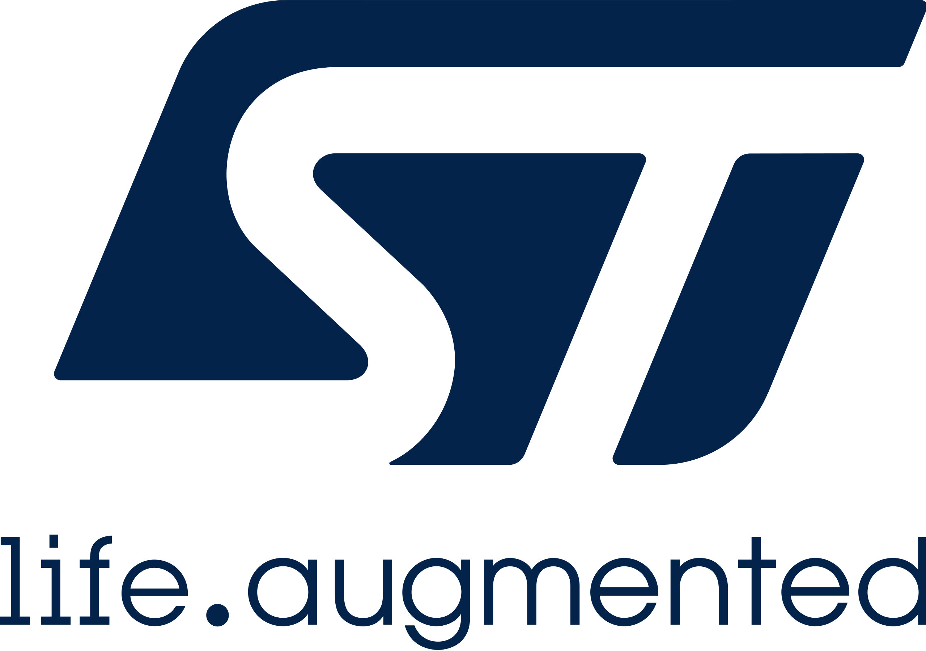
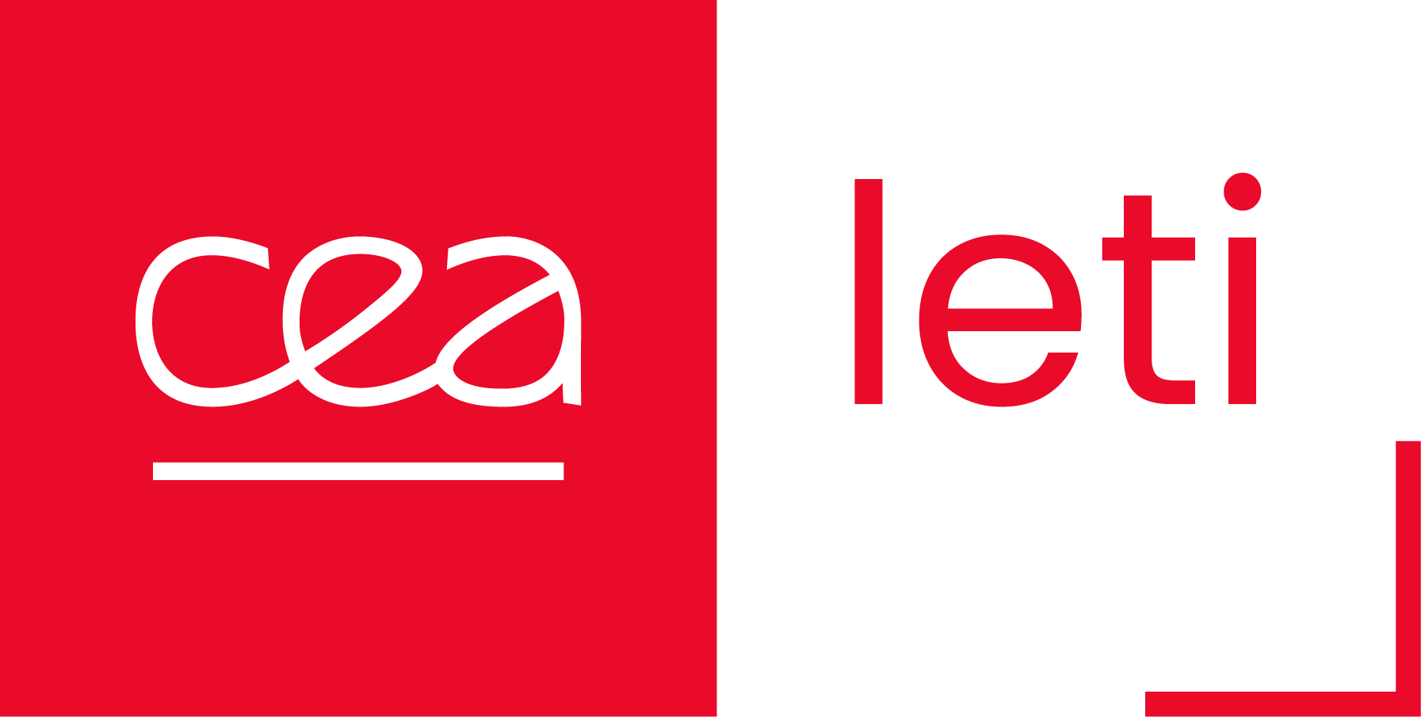
EU leaders in the semiconductor value chain
Material
Semiconductor
Epitaxial Wafers
IDM
Raw silicon wafers
Photomask
Design & Conception
Front-end
Back-end
Raw materials
IP
OSAT
Pure-Play Foundries
EDA
IC Substrate
Fabless
Equipment
Back-end
Front-end
Source: DECISION Etudes & Conseil, 2023
Lithography
Research & Technology Organizations
Etching and cleaning
Others
Diffusion, implantation & Deposition
Methrology & quality control
Other Front-end

Slide 24
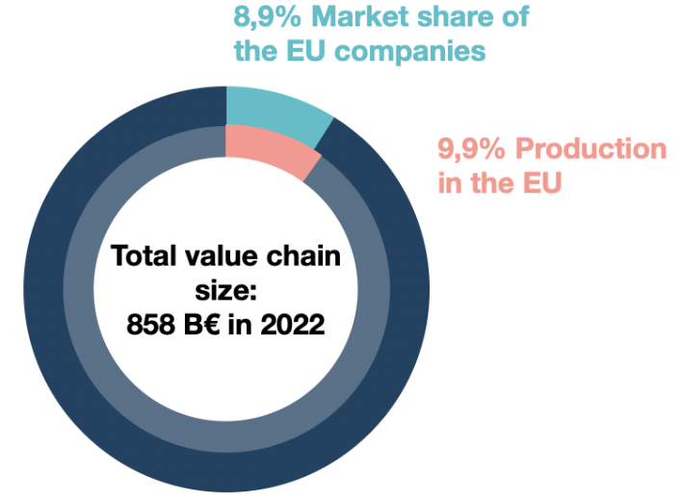
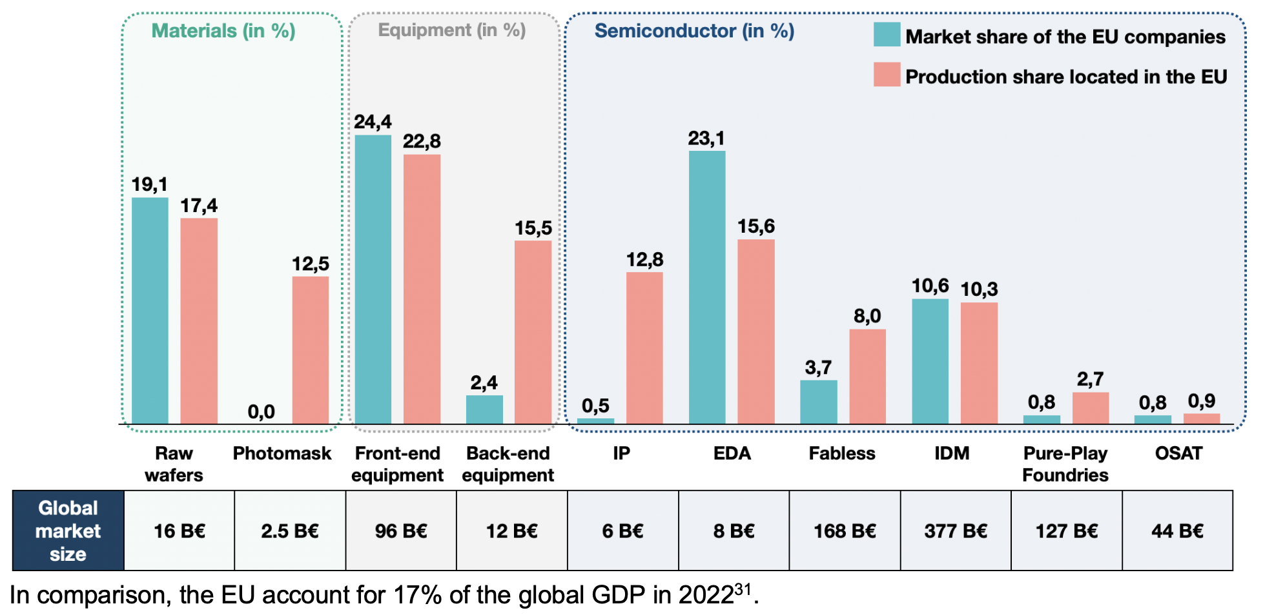
Market and production shares of EU players in 2022
Source: DECISION Etudes & Conseil
Notes:
Photomasks: Advanced Mask Technology Center (JV GF – Toppan), 320 employés Dresden
DNP, Toppan, Photronics

Slide 25
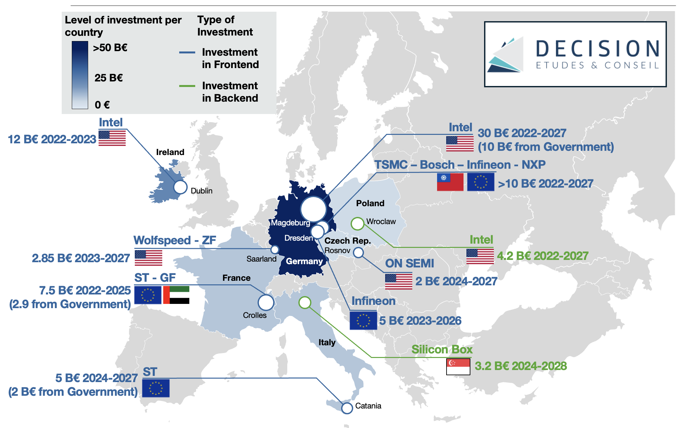
EU Chips Act
Key investments in the EU (>1B€)
In total, €106B public and private investment
58% of investments from US companies
€37B delayed

Slide 26
Future scenarios
Progressive de-risking, regionalization of value chains
Renewed US-China Economic Understanding (including a deal on Taiwan?)
Escalation (likely around Taiwan) -> Value chain disruption, decoupling
In any scenario, how to ensure a resilient EU semiconductor ecosystem?
Considering our key export markets: Asia, China, Taiwan, North America
Addressing our weaknesses & strategic dependencies

Slide 27
Challenges & opportunities for the EU
(non-exhaustive)
Challenges
Talent gap: 75 400 workers lacking by 2030
Find equilibrium between Asia and America
…
Opportunities
Develop new industrial policy tools to adjust industrial policies from third countries
Strengthen the EU ecosystem of design of advanced processors
…

Slide 28
Thank you for your attention
Léo Saint-Martin
Partner, DECISION Etudes & Conseil saint-martin@decision.eu
+33 6 31 18 91 84

